Slide 1
Hypothesis Testing Biology 683 Lecture 4 Heath Blackmon

Slide 2
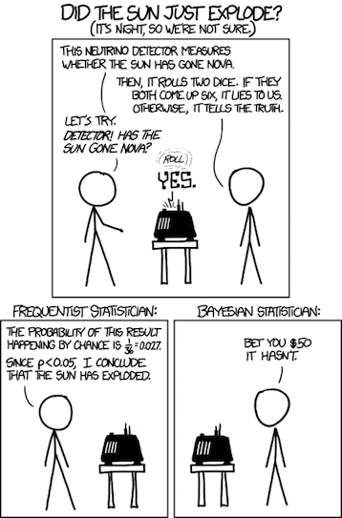
Last week
What is “unfair” about this comic?
Give a biological example of a conditional probability

Slide 3
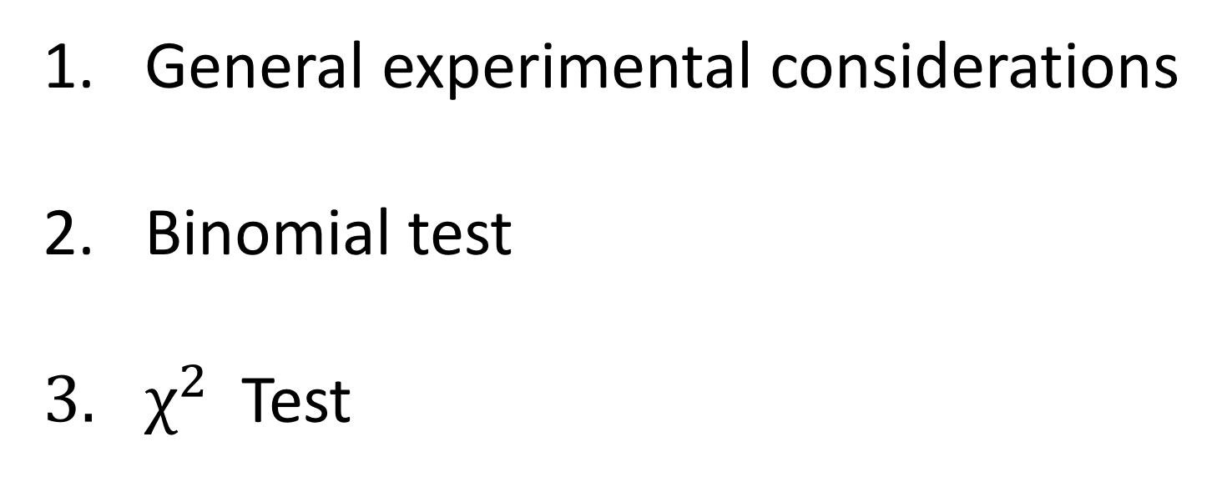
Today
General experimental considerations
Binomial test
$χ^{2}$ Test

Slide 4
Some Experimental Design Considerations
Why do I need a control?
Hardly anything is absolute – we are comparing things to each other
To interpret an experiment, we need to compare the experimental subjects to the correct reference group
What is an appropriate control?
Ideal controls are identical to the experimental population, except for the one parameter being manipulated
The control population should be similar in all other respects to the experimental population
The control population should experience sham manipulations that simulate any manipulations applied to the experimental population
Sometimes I might need multiple different controls.

Slide 5

Avoiding Experimenter Bias
Experimenter bias is real
The results of your study can be influenced by your expectations
Some precautions
Randomize assignment of subjects to controls and treatments (use R or random.org). Humans are bad at recognizing randomness.
sample(c("H", "T"),
replace = T,
size = 10)
H H H H T T T H T H H H T T T T H H H H
T H T T H T H T H H T T H H T H T T H T

Slide 6
Avoiding Experimenter Bias
Use a blind or double-blind experimental design
Blind: the subject doesn’t know whether it’s an experimental or control subject
Double-blind: neither the researcher nor subject know which subjects are experimental versus control
How can you apply this to your research?

Slide 7
Confounding Variables
A difference between groups that the experimenter fails to account for
A hidden variable that creates an apparent causal relationship that isn’t real
An experiment with confounded variables can be impossible to interpret and impossible to fix

Slide 8
Confounding Example
Study type Confounding variable
Expression level recent gene duplication
Diversification unobserved traits
Lung cancer and coffee coffee smoking correlation
Behavior maternal effects
Effective population size elevated inbreeding

Slide 9
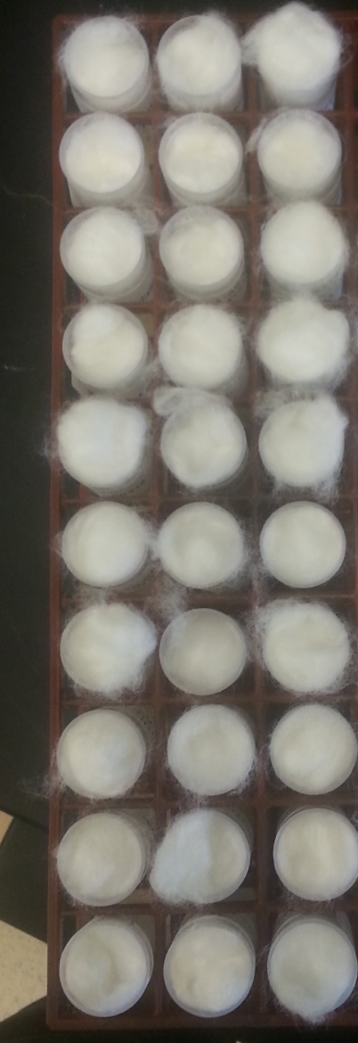
Redesign the procedure
Collect 750 beetles from a population cage.
Create 30 new vials with 25 beetles each.
Make the first 15 of these control vials and use food media A.
Make the next 15 of these experiment vials and use food media B.
Place in a rack as shown and place in the incubator.
Media A
Media B

Slide 10
Pseudoreplication
Occurs when measured subjects are not independent draws from the population
10 rats are studied and tested on three consecutive days, resulting in 15 observations for the control group and 15 observations for the treatment groups
The experiment is conducted in two tanks: tank 1 has EE2 added, tank 2 is the control tank. 10 fish are tested per tank.
We are testing for the effects of monogamy on brain transcript levels. We use 5 monogamous seahorses and 5 polygamous pipefishes from a single genus. Why is this pseudoreplication?
Fish are segregated by sex into two tanks, with 10 individuals per tank. I draw a pair at random and test them, returning them to the tanks at the end. I perform a total of 40 such tests. What’s the problem?

Slide 11
Biological and Technical Replicates
A biological replicate involves a new, independent test subject
A technical replicate involves repeating the same procedure on a new sample from the same subject
Technical replicates do not contribute to your estimates of population-level parameters, but they can increase the precision of measurements on individuals

Slide 12
Which kind of replication
In general, biological replicates are superior to technical replicates, because biological replicates increase power.
Technical replicates are useful when the technique in question sometimes produces extremely inaccurate results, which must be pruned from the dataset. An example is qPCR, where occasional extreme outliers are common.

Slide 13
Best Practices
Ensure as much as possible that controls and experimental individuals are from identical populations (except for the factor of interest)
Treat your controls as similarly as possible to the experimental subjects (sham injections, placebos, etc.)
Conduct your control manipulations in parallel with your experimental manipulations
Think about all possible confounding variables and establish a plan to eliminate or correct for them before you start!

Slide 14
Everything I do is an Experiment
You should approach everything you do in the lab from the perspective of an experiment
Always do the appropriate controls for PCR, transformations, etc.
Troubleshooting is experimenting
Think about how you will describe the experiment before you embark on it
You will see that simplicity is extremely valuable
Think about the analysis you will do before you get started
In science, if you don’t publish it, then you didn’t do it

Slide 15
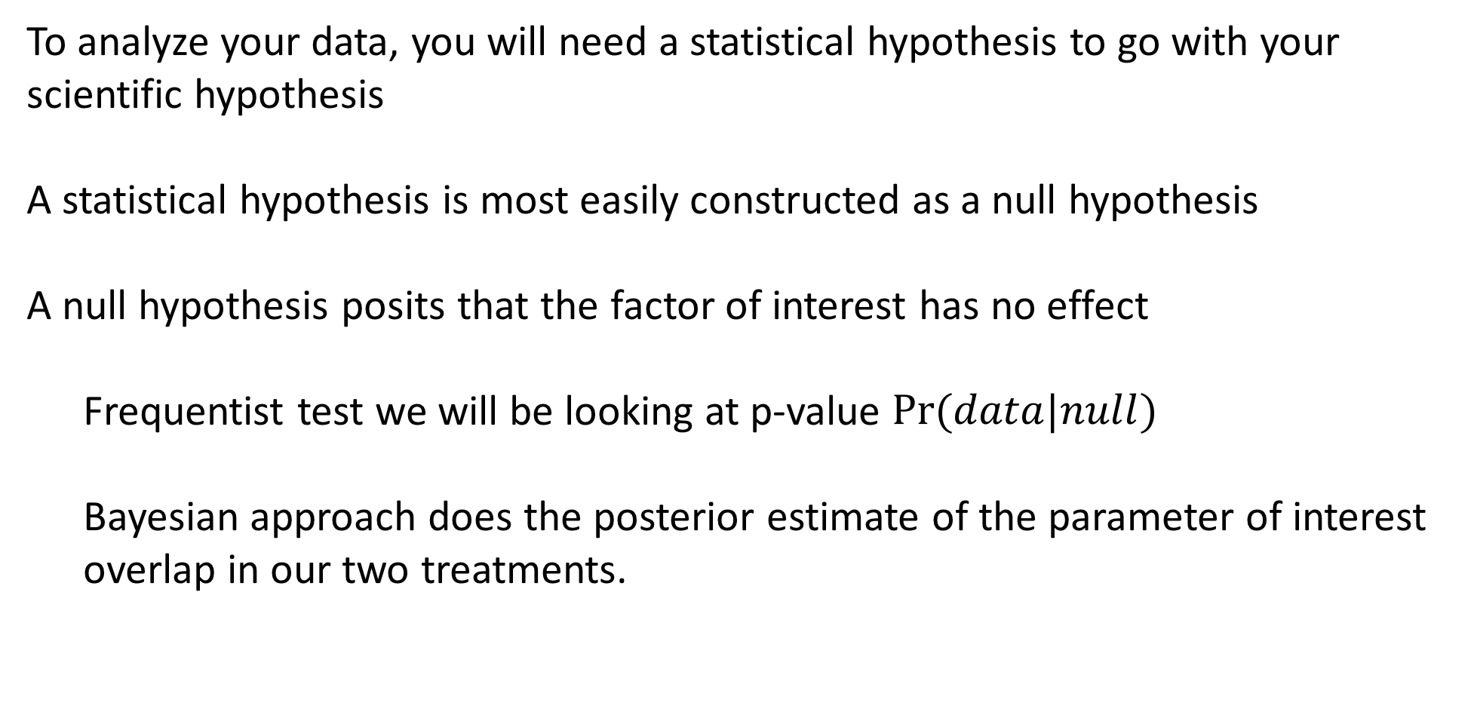
The Null Hypothesis
To analyze your data, you will need a statistical hypothesis to go with your scientific hypothesis
A statistical hypothesis is most easily constructed as a null hypothesis
A null hypothesis posits that the factor of interest has no effect
Frequentist test we will be looking at p-value $Pr⁡(data|null)$
Bayesian approach does the posterior estimate of the parameter of interest overlap in our two treatments.

Slide 16
Examples of Null Hypotheses
Fertilizer has no effect on the growth rate of oak trees.
Blocking olfactory cues has no effect on mate choice in swordtail fishes.
Rates of genome evolution are the same in two populations.
Mutations in the 5’ UTR of msl-2 have no effect on translation.

Slide 17
Rejecting the Null
Your statistical test will attempt to reject the null hypothesis
If you reject the null, then one of the alternative hypotheses must be true – though not necessarily the one you think is coolest!
You cannot prove a hypothesis, but you can find support for an alternative or reject the null.

Slide 18
Type I versus Type II Error
Type I error refers to rejecting a true null hypothesis
Type II error refers to failing to reject a false null hypothesis
Power is a description of our probability of rejecting a false null hypothesis
We usually set up statistical tests to avoid Type I errors, at the expense of possibly committing Type II errors
Type I error = FALSE POSITIVE
1 – Type 2 error = POWER

Slide 19
Analyzing Proportions
Several chapters in the book deal with this topic
The experiment boils down to this:
I have identified two groups
The groups differ with respect to one factor
I am interested in the frequency of occurrence of something else as a function of this factor
When would this type of problem come up in the biological sciences?

Slide 20
Analyzing Proportions
Epidemiological Studies
Does Zika virus cause Guillain-Barre syndrome?
Compare proportion of Zika infected people with Guillain-Barre to the proportion of uninfected people with Guillain-Barre
Eating at Chipotle causes E. coli infections.
Does Helicobacter pylori cause stomach cancer?

Slide 21
Binomial Test
An exact test to determine whether or not the observed proportion adheres to the expected proportion under the null hypothesis
Some possible uses:
Are frogs equally likely to be right or left handed?
Is the sex ratio half male and half female?
Are the offspring phenotypes a 3:1 ratio?

Slide 22
Binomial Test
As in most statistical tests, a test statistic is compared to a distribution
In this case, the test statistic is just the observed number (number of right-handed toads, number of females in the population)
Note that this test is only appropriate when there are two categories of individuals

Slide 23
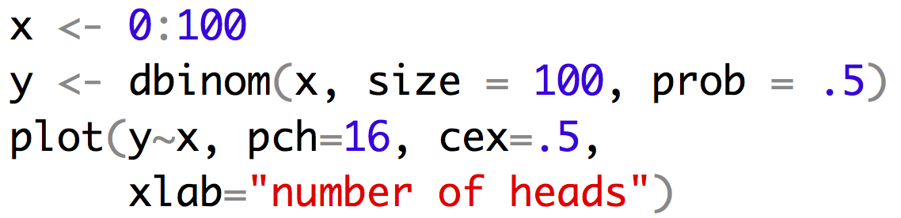
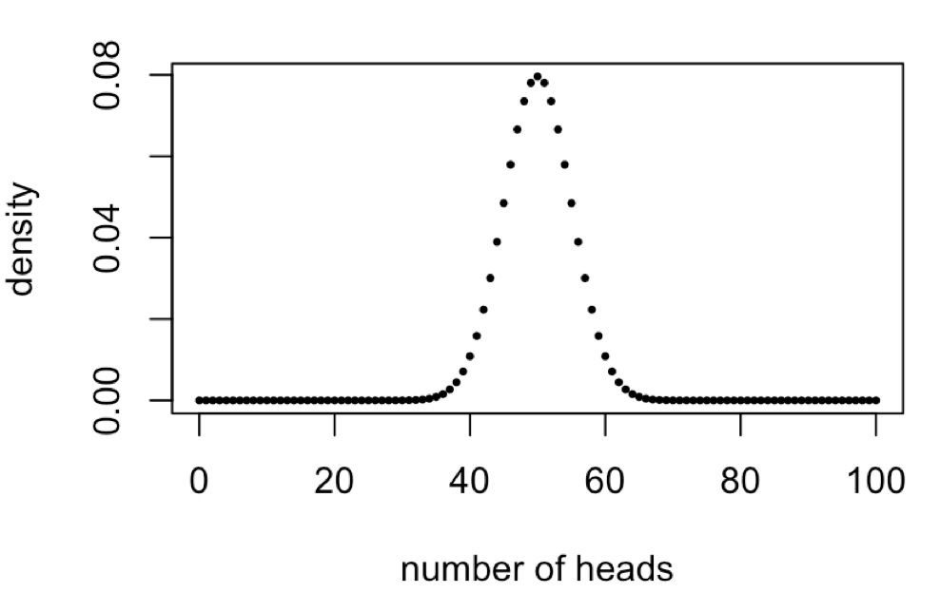
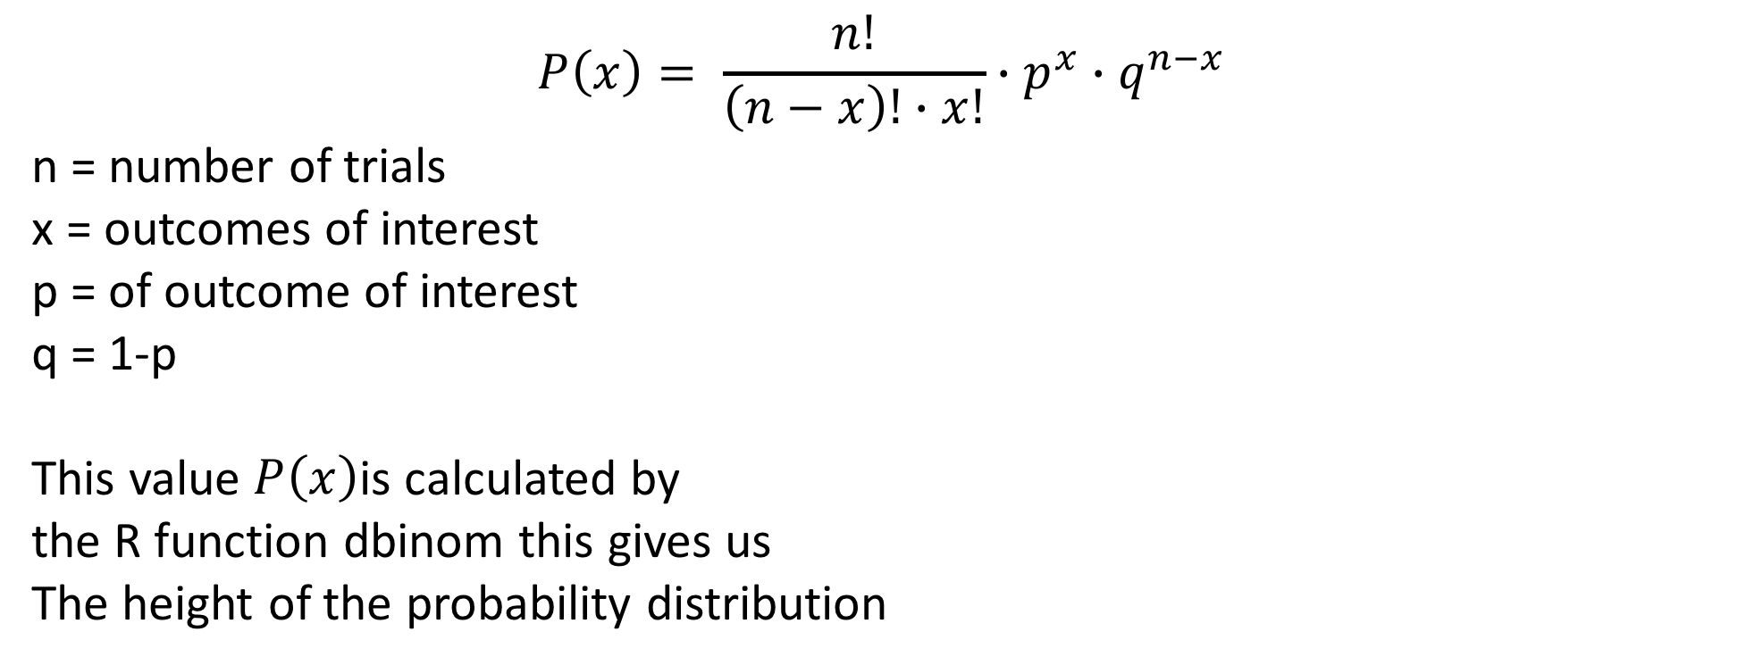
Binomial Test
$$P\left(x\right)= \frac{n!}{\left(n−x\right)!∙x!}∙p^{x}∙q^{n−x}$$
n = number of trials
x = outcomes of interest
p = of outcome of interest
q = 1-p
This value $P\left(x\right)$is calculated by
the R function dbinom this gives us
The height of the probability distribution

Slide 24
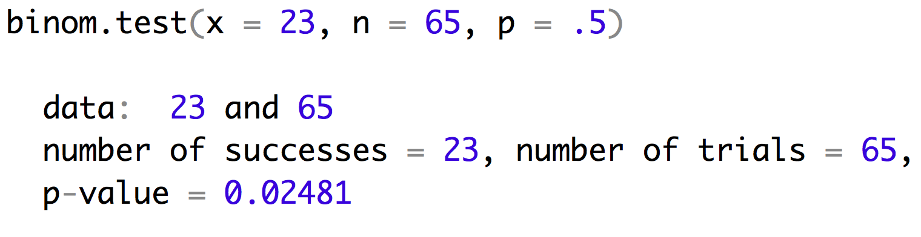
Binomial Test
Lets look at an example with sex ratio. You are hybridizing closely related species (with XY sex chromosomes) so you know Haldane’s rule states that the males might be more rare. When you survey the offspring you find 23 males out of 65 offspring.

Slide 25
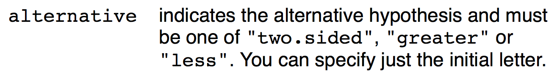
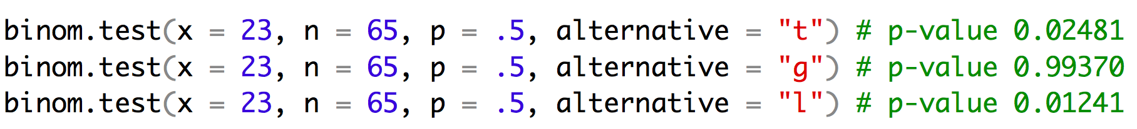
Binomial Test
binom.test has an argument alternative

Slide 26
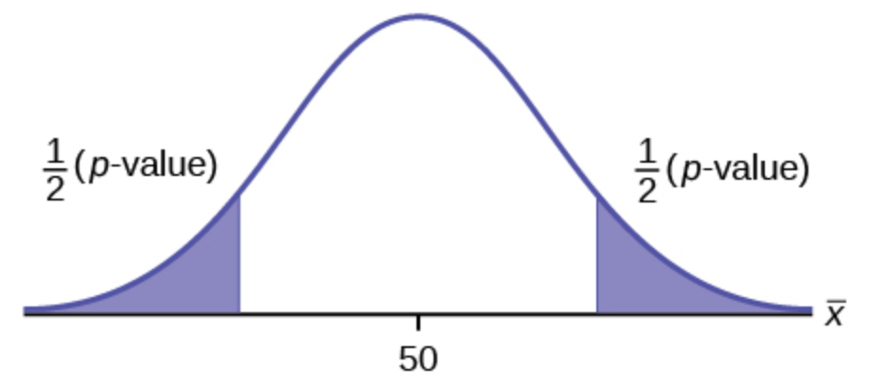
Binomial Test
Alternative = two.sided
What is the probability that I would see a skew in the sex ratio this great or greater.
In this case our observed number of males was -1.2 standard deviations from the mean. So our p-value is the area under the curves above 1.2SD and below -1.2SD.
-1.2 SD
1.2 SD

Slide 27
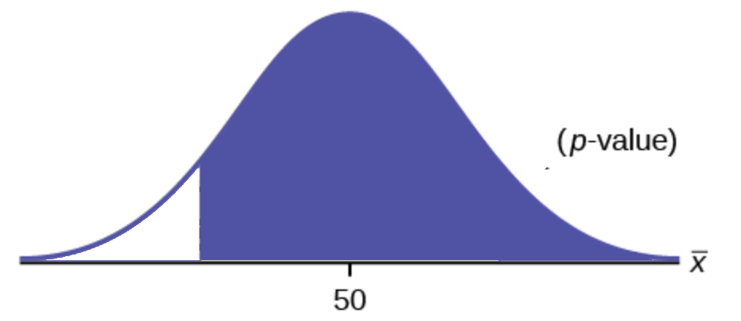
Binomial Test
Alternative = greater
What is the probability that I would see a larger number of males.
In this case our observed number of males was -1.2 standard deviations from the mean. So our p-value is the area under the curves above -1.2SD.
-1.2 SD

Slide 28
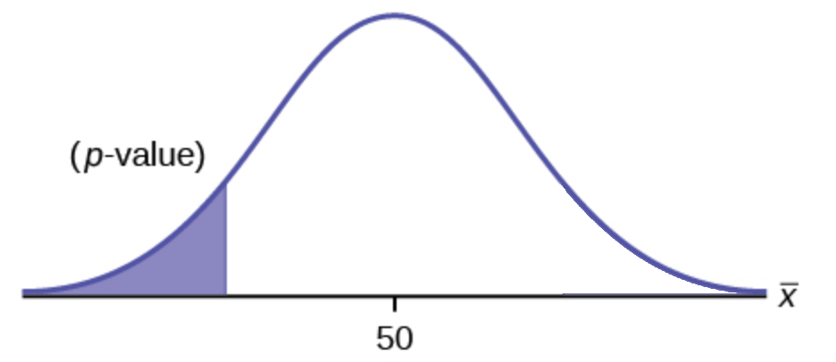
Binomial Test
Alternative = less
What is the probability that I would see this many or fewer males.
In this case our observed number of males was -1.2 standard deviations from the mean. So our p-value is the area under the curves below -1.2SD.
-1.2 SD

Slide 29
Reporting the Results
This populations shows a significant departure from a 1:1 sex ratio (0.35, 95% CI: 0.24-0.48, binomial test, n = 65, p < 0.025).
For very small p-values, we just say that p is very small (< 0.001 or < 0.0001).
Most journals/subdisciplines will have conventions about how certain tests are presented.
Most journals italicize mathematical variables, so n and p would be italicized. They also normally would be lower case.

Slide 30
$χ^{2}$ Test
This test compares the observed number in each category to expectations based on the null hypothesis (if there are only two categories, it approximates the binomial test)
It can also be used to test for independence of two variables, and then it is called a contingency χ2-test.
Lets dig into that Titanic data and
see if females were more likely to
Female adults on the Titanic
 | Survived | Died
1st | 140 | 4
2nd | 80 | 13
3rd | 76 | 89
Crew | 20 | 3

Slide 31
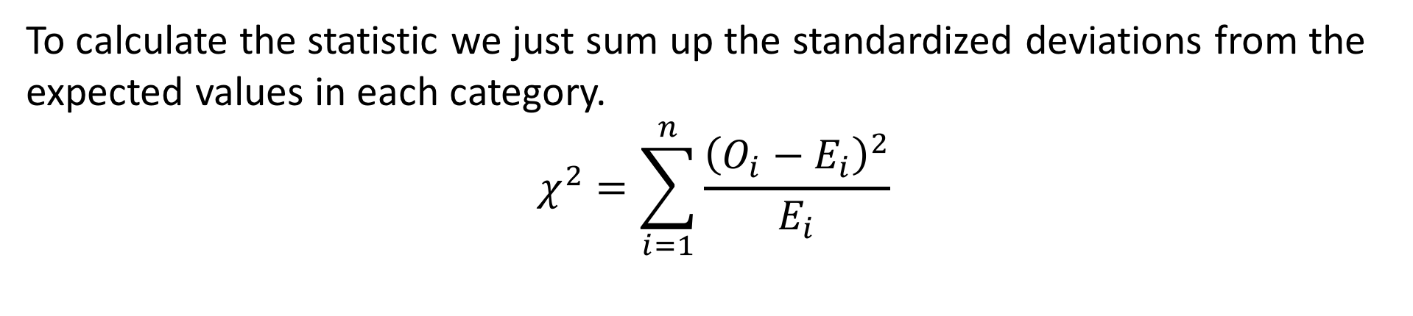
$χ^{2}$ Test
To calculate the statistic we just sum up the standardized deviations from the expected values in each category.
$$χ^{2}=\sum_{i=1}^{n}{\frac{{\left(O_{i}−E_{i}\right)}^{2}}{E_{i}}}$$
Female adults on the Titanic
 | Survived | Died
1st | 140 | 4
2nd | 80 | 13
3rd | 76 | 89
Crew | 20 | 3

Slide 32
$χ^{2}$ Test
To calculate the statistic we just sum up the standardized deviations from the expected values in each category.
$$χ^{2}=\sum_{i=1}^{n}{\frac{{\left(O_{i}−E_{i}\right)}^{2}}{E_{i}}}$$
Female adults on the Titanic
 | Survived | Died | total
1st | 140 | 4 | 144
2nd | 80 | 13 | 93
3rd | 76 | 89 | 165
Crew | 20 | 3 | 23
total | 74.4% | 25.6%

Slide 33
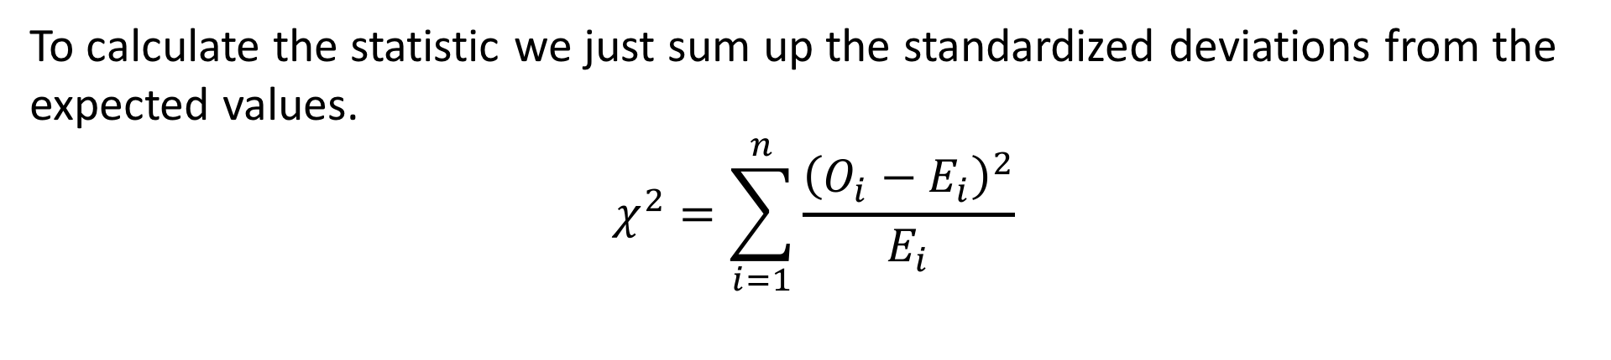
$χ^{2}$ Test
To calculate the statistic we just sum up the standardized deviations from the expected values.
$$χ^{2}=\sum_{i=1}^{n}{\frac{{\left(O_{i}−E_{i}\right)}^{2}}{E_{i}}}$$
Female adults on the Titanic
 | Survived | Died
1st | 140 | 4 | 144
2nd | 80 | 13 | 93
3rd | 76 | 89 | 165
Crew | 20 | 3 | 23
total | 74.4% | 25.6%
Expected
 | Survived | Died
1st | .744 x 144 | .256 x 144
2nd | .744 x 93 | .256 x 93
3rd | .744 x 165 | .256 x 165
Crew | .744 x 23 | .256 x 23

Slide 34
$χ^{2}$ Test
To calculate the statistic we just sum up the standardized deviations from the expected values.
$$χ^{2}=\sum_{i=1}^{n}{\frac{{\left(O_{i}−E_{i}\right)}^{2}}{E_{i}}}$$
Female adults on the Titanic
 | Survived | Died
1st | 140 | 4 | 144
2nd | 80 | 13 | 93
3rd | 76 | 89 | 165
Crew | 20 | 3 | 23
total | 74.4% | 25.6%
Expected
 | Survived | Died
1st | 107 | 37
2nd | 69 | 24
3rd | 123 | 42
Crew | 17 | 6

Slide 35
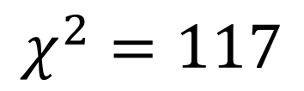
$χ^{2}$ Test
To calculate the statistic we just sum up the standardized deviations from the expected values.
$$χ^{2}=\sum_{i=1}^{n}{\frac{{\left(O_{i}−E_{i}\right)}^{2}}{E_{i}}}$$
Observed
 | Survived | Died
1st | 140 | 4
2nd | 80 | 13
3rd | 76 | 89
Crew | 20 | 3
Expected
 | Survived | Died
1st | 107 | 37
2nd | 69 | 24
3rd | 123 | 42
Crew | 17 | 6
$$χ^{2}=117$$

Slide 36
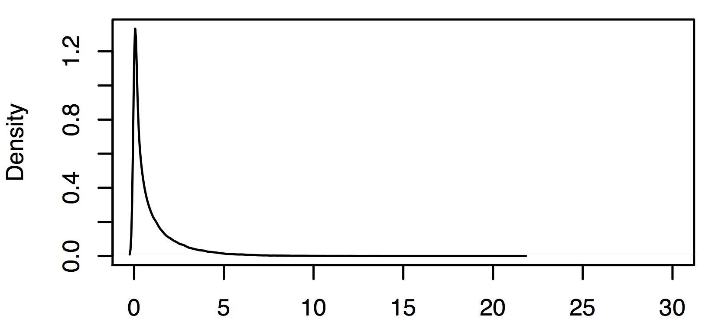
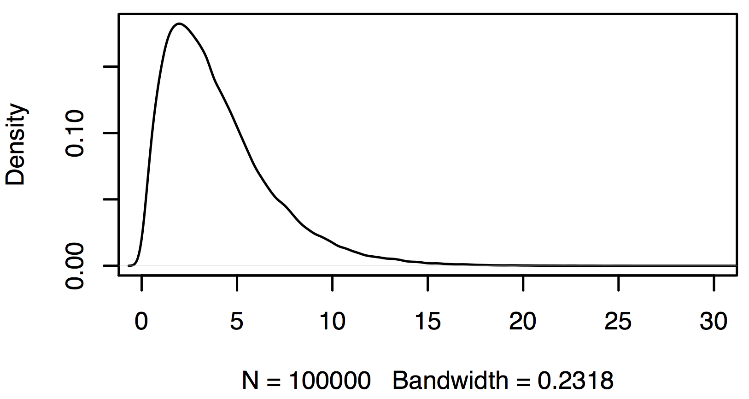
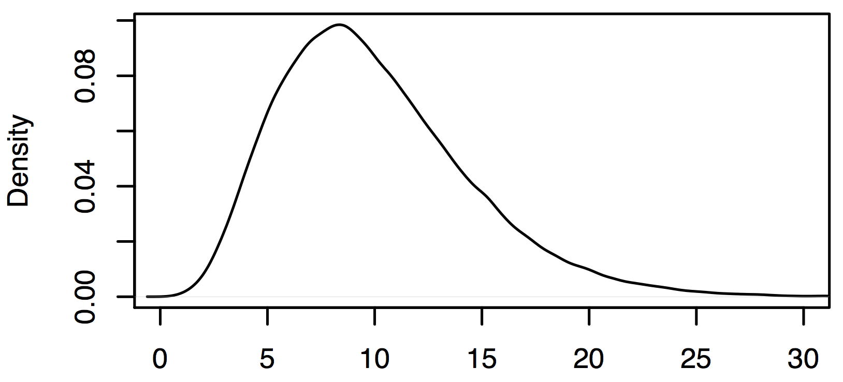
$χ^{2}$ Test
The shape of the chi square distribution depends on the degrees of freedom (df).
df = (no. rows – 1)(no. cols -1)
df = (4– 1)(2 -1)
df = 3
df=1
Female adults on the Titanic
 | Survived | Died
1st | 140 | 4
2nd | 80 | 13
3rd | 76 | 89
Crew | 20 | 3
df=3
df=10

Slide 37
$χ^{2}$ Test
The shape of the chi square distribution depends on the degrees of freedom (df).
df = (no. rows – 1)(no. cols -1)
df = (4– 1)(2 -1)
df = 3
df=1
Female adults on the Titanic
 | Survived | Died
1st | 140 | 4
2nd | 80 | 13
3rd | 76 | 89
Crew | 20 | 3
df=3
df=10

Slide 38
Some other tests
An odds ratio test compares the probability of something happening in two different groups: odds of cancer in smokers versus non-smokers
The Fisher’s Exact Test computes exact probabilities (much like the binomial test) for a 2x2 contingency table
A G-test of independence is basically a χ2-test with a slightly different test statistic

Slide 39
For Thursday
Read chapter WS 6-9
Bring laptop to class!
Heath Blackmon
BSBW 309
coleoguy@gmail.com
@coleoguy

